Slide 1


Scheduling Chip Operations
with Tabu Search
Using fewer hardware units when designing a chip
Soaib Ferdous
Student ID: 1232368 | Group B, Team 6
HW/SW Co-Design Seminar — Hochschule Hamm-Lippstadt
1 / 11
Notes:
Introduce yourself and the topic in plain words: this talk is about using fewer hardware units when designing a chip, using a smart search method called Tabu Search.

Slide 2
Why This Matters
Building a chip means building real hardware for every operation — every multiply, every addition.
Each extra hardware unit costs more chip space and more money.
So the question is simple:
Fewer units means:
Smaller chip
Lower cost
Less power use
“How few hardware units can we get away with?”
2 / 11
Notes:
Explain the cost angle simply: every operation needs real hardware, and hardware costs money and chip space. Set up the core question the whole talk answers.

Slide 3

The Problem, in Plain Words
Think of every chip operation as a small task:
Earliest start
Deadline
Duration
Order
when it's allowed to begin
when it must be finished
how many clock cycles it takes
which tasks must finish first
Goal: fit every task onto as few hardware units as possible, without breaking any deadline or order.
3 / 11
Notes:
Walk through the four task properties in plain words, avoid technical symbols. End on the clear goal statement.

Slide 4
Why We Can't Just Solve It Perfectly
Too Many Possibilities
With 1000 operations…
0
Trying every possible schedule takes too long once we have more than a handful of operations.
This is a well-known type of problem in computer science — there's no shortcut to checking every option.
solutions found by the exact method — even after 10 minutes of computing
We need a smarter, faster approach — Tabu Search.
4 / 11
Notes:
Explain NP-hardness in plain terms: too many combinations to check by hand or by brute force. Emphasize the dramatic '0 solutions at 1000 operations' stat as the turning point of the talk.

Slide 5
Meet TS-PRED — Three Simple Steps
1
2
3
Prepare
First Try
Improve
Tighten the schedule using task order, so we know each task's real time window
Place every task one by one, using as few hardware units as possible
Keep tweaking the schedule, trying to use even fewer units
5 / 11
Notes:
Walk through the three phases at a high level using the seat-rearranging or worker-assignment analogy if helpful.

Slide 6




How the “Improve” Step Works
Like rearranging seats to fit everyone at fewer tables
Shake things up
Try a new spot
Swap if needed
Keep what works
Remove a few tasks from the schedule on purpose
Slot each removed task back in wherever it fits best
Trade places with a shorter task if there's no room
Only accept the change if it doesn't need more units
A short “no repeat” rule stops the search from undoing its own progress.
6 / 11
Notes:
Use the seat-rearranging analogy explicitly here. Explain perturb/insert/exchange/tabu tenure without using those exact technical words unless asked.

Slide 7

We Built and Tested It in C++
struct Job { earliest start, deadline, duration, requirements };
struct Processor { the tasks assigned to it };
struct Solution { all processors in use };
// the “no repeat” window shrinks as more units are freed up
We didn't just write it — we compiled and ran it.
The next slide shows the real output.
7 / 11
Notes:
Show that this was actually implemented and tested, not just theoretical. Keep code explanation light — point at structure names, not deep C++ details.

Slide 8
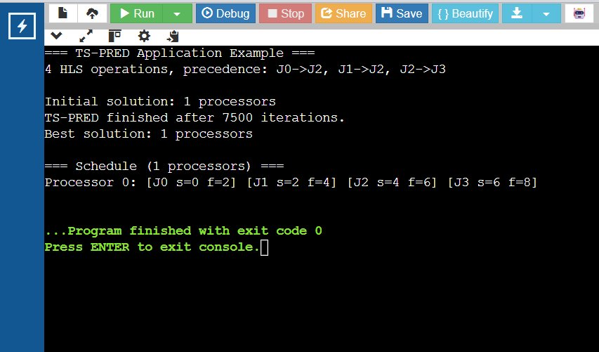
Example: Scheduling 4 Operations
2 multiplications, 2 additions — with a fixed order between them
Task | Type | Starts after
J0 | Multiply | —
J1 | Multiply | —
J2 | Add | J0 and J1
J3 | Add | J2
Result: 1 hardware unit is enough — the tasks naturally fit one after another.
Real, verified output from our C++ program
8 / 11
Notes:
Walk through the 4-job example step by step in plain language. Point to the screenshot as proof it was actually run.

Slide 9

Does It Work Well?
In short:
Our method lands within about 1% of the perfect answer
It's several times faster than the older method
It even works on problems the exact method can't solve at all
9 / 11
Notes:
Present the chart simply: smaller bar is better, our method is close to perfect, older method is much further off.

Slide 10


What's Good, What's Not
Strengths
Limitations
Always finds a working schedule
Very close to the perfect answer
Handles task ordering, unlike older methods
No guarantee it's the perfect answer
Assumes all hardware units are identical
Only optimises unit count, not power or area
Future idea: combine with smarter, evolving search methods and support different unit types
10 / 11
Notes:
Be balanced and honest about real strengths and real limitations. This shows critical thinking.

Slide 11

Thank You
Questions & Discussion
Tabu Search lets us schedule chip operations using fewer hardware units — fast enough for real designs, and close enough to perfect to trust.
Soaib Ferdous | 1232368 | HW/SW Co-Design Seminar | HSHL
11 / 11
Notes:
Wrap up with the one-sentence takeaway. Open the floor for questions. Be ready to explain tabu tenure or NP-hardness in plain language if asked.

